Slide 1
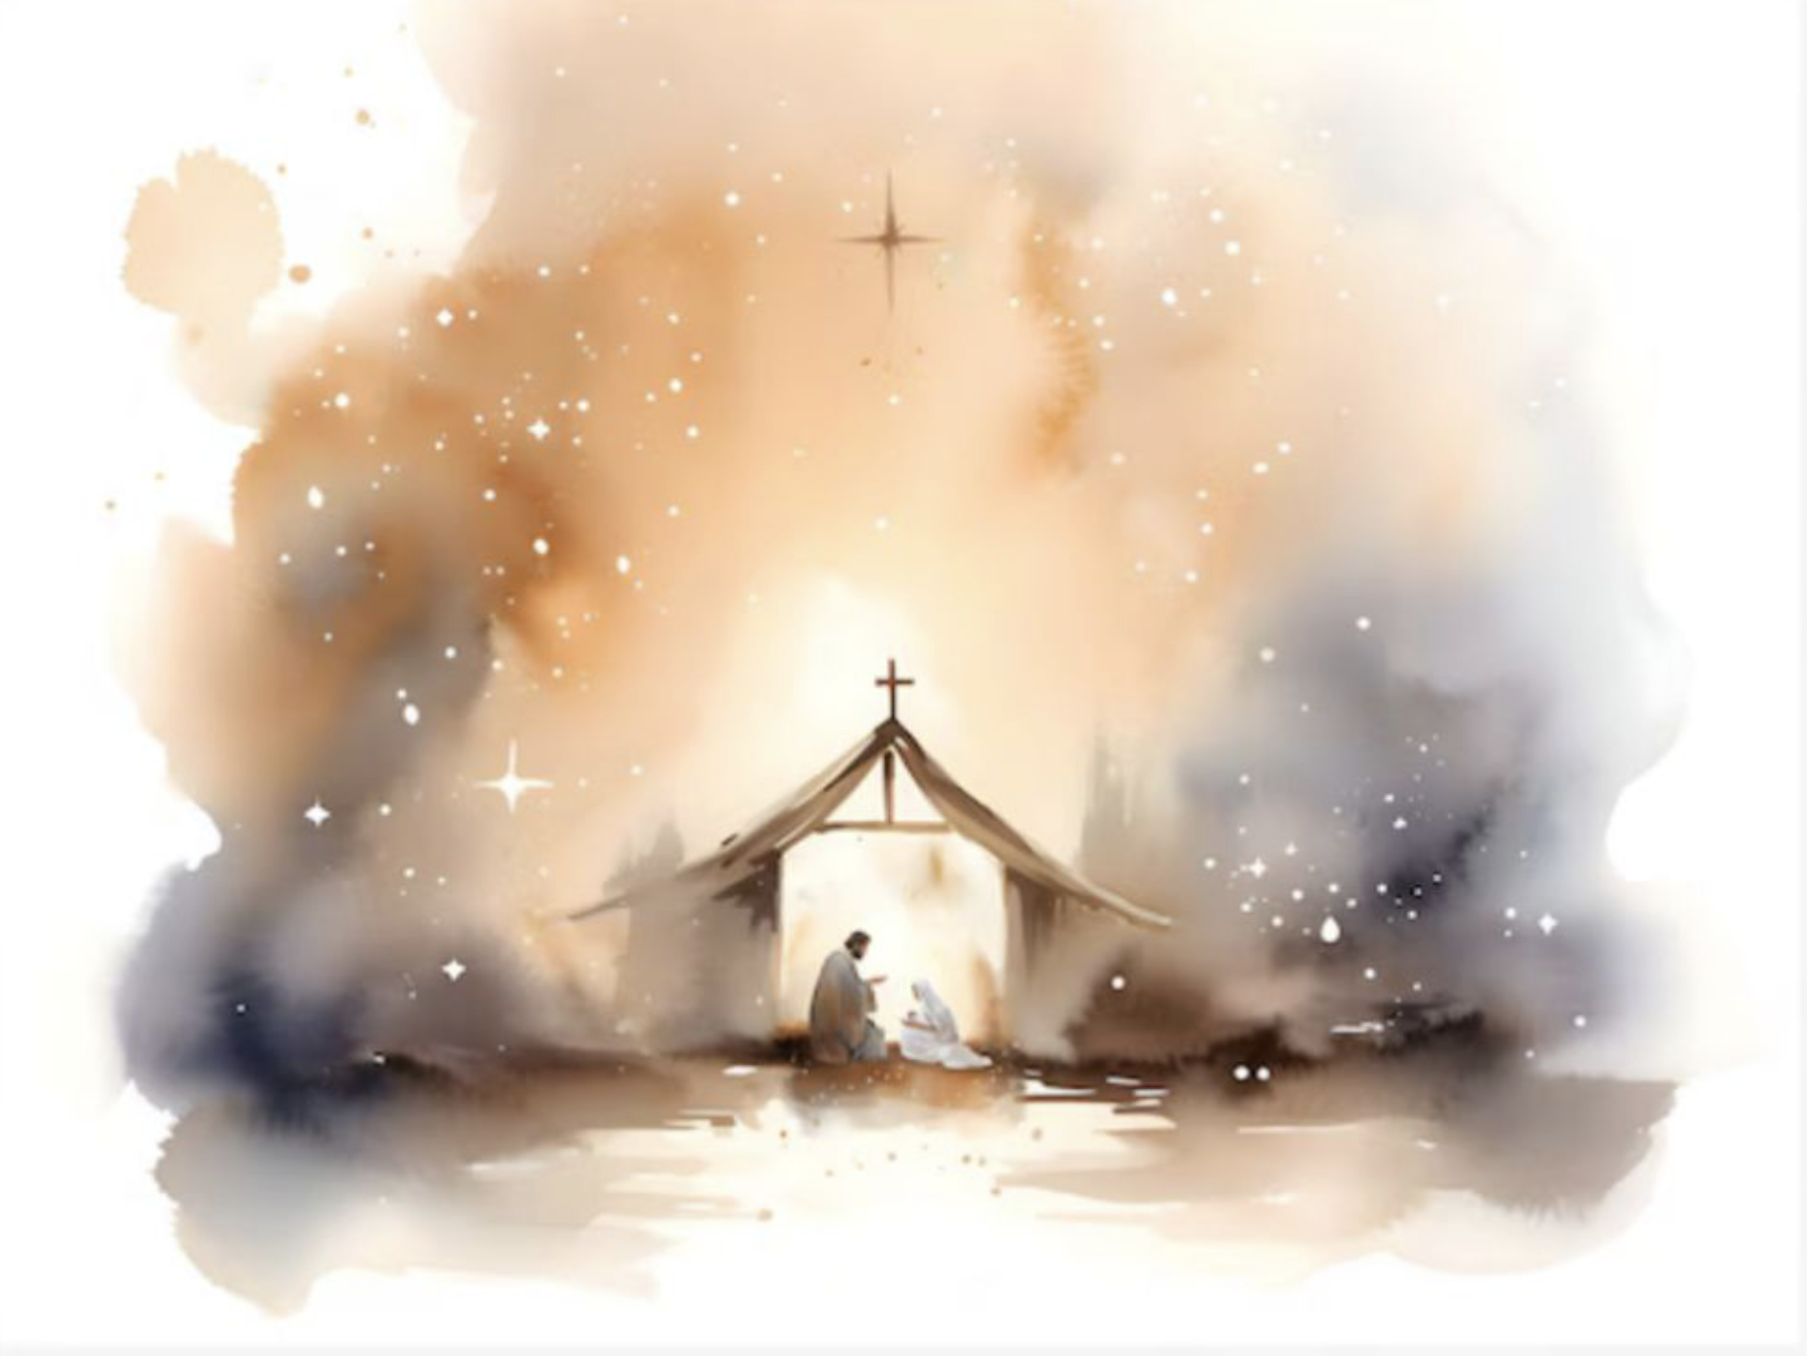
因有一嬰孩為我們而生
For Unto Us A Child Is Born
From Handel's Messiah #12
選自聖經 以賽亞書 9:6

Slide 2
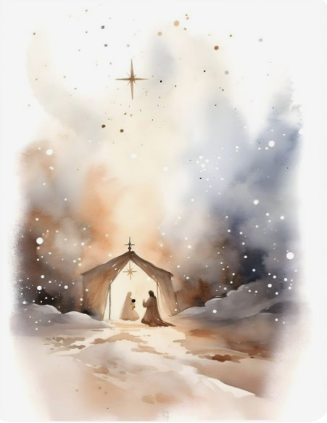
A
(S)
For unto us a Child is born,
unto us a Son is given, unto us a Son is given,
(T)
For unto us a Child is born,
(S)
For unto us a Child is bOrn…
(T)
unto us a Son is given, unto us a Son is given:
因有一嬰孩為我們而生
有一子賜給我們

Slide 3
B
(A)
For unto us a Child is born,
(B)
For unto us a Child is bOrn…
(A)
unto us a Son is given, unto us a Son is given,
(B)
unto us a Son is given:
unto us a Son is given:
(A)
因有一嬰孩為我們而生
有一子賜給我們

Slide 4
C
(T)
and the government shall be upon His shoulder—
(S)
and the government shall be upon His shoulder—
(A)
and the government shall be upon His shoulder,
(B)
and the government shall be upon His shoulder,
(S)
upon His shoulder,
(SATB)
and His Name shall be called
政權必擔在祂的肩頭上, 祂名稱為

Slide 5
D
Wonderful, Counsellor, The Mighty God,
The Everlasting Father, The Prince of Peace.
奇妙 策士 全能的上帝
永在的父 和平的君

Slide 6
D
(A)
Unto us a Child is born,
(T)
For unto us a Child is bOrn…
(A)
unto us a Son is given:
(S)
Unto us a Child is born,
(B)
unto us a Son is given:
因有一嬰孩為我們而生
有一子賜給我們

Slide 7
D
(A)
and the government shall be upon His shoulder—
(B)
and the government shall be upon His shoulder
(S)
and His Name
(T)
and His Name
(A)
and His Name
(B)
and His Name
(SATB)
shall be called
政權必擔在祂的肩頭上, 祂名稱為

Slide 8
E
Wonderful, Counsellor, The Mighty God,
The Everlasting Father, The Prince of Peace.
奇妙 策士 全能的上帝
永在的父 和平的君

Slide 9
E
(T)
Unto us a Child is born,
(S)
For unto us a Child is born,
(B)
For unto us a Child is born,
(A)
For unto us a Child is bOrn…
(B)
unto us a Son is given:
(S)
unto us a Son is given:
(T)
unto us a Son is given:
因有一嬰孩為我們而生
有一子賜給我們

Slide 10
E
(T)
and the government shall be upon His shoulder,
(S)
and the government shall be upon His shoulder,
(A)
and the government shall be upon His shoulder,
(B)
and the government shall be upon His shoulder,
(SATB)
and His Name shall be called
政權必擔在祂的肩頭上, 祂名稱為

Slide 11
F
Wonderful, Counsellor, The Mighty God,
The Everlasting Father, The Prince of Peace.
奇妙 策士 全能的上帝
永在的父 和平的君

Slide 12
F
(B)
Unto us a Child is born,
(S)
For unto us a Child is bOrn…..
(A)
For unto us a Child is bOrn…..
(T)
For unto us a Child is born,
(B)
For unto us a Child is born,
unto us a Son is given, unto us a Son is given,
unto us a Son is given, unto us a Son is given,
(SATB)
unto us a Son is given:
因有一嬰孩為我們而生,
有一子賜給我們

Slide 13
and the government the government shall be upon His shoulder,
F
(S)
(A)
and the government shall be upon His shoulder,
(T)
and the government
(B)
and the government
(SATB)
(and) the government shall be upon His shoulder,
and His Name shall be called
政權必擔在祂的肩頭上, 祂名稱為

Slide 14
G
Wonderful, Counsellor, The Mighty God,
The Everlasting Father, The Prince of Peace.
奇妙 策士 全能的上帝
永在的父 和平的君

